Slide 1
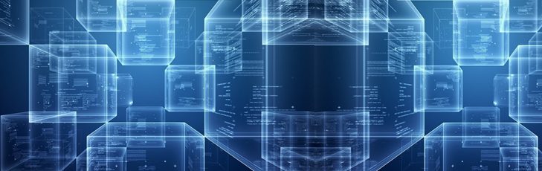


2. Intro to Blockchain
Melanie Swan
Founder, Institute for Blockchain Studies
melanie@BlockchainStudies.org
www.BlockchainStudies.org
Slides: http://slideshare.net/LaBlogga

Slide 2

Thesis
Blockchain technology is not just about cryptocurrencies, registering wills and IP on blockchains, and bank transfers taking less than 3 days to settle, philosophically blockchains invite a new level of thinking about the sensibility of the Cryptocitizen and possibilities for societal shared trust
http://www.amazon.com/Bitcoin-Blueprint-New-World-Currency/dp/1491920491

Slide 3
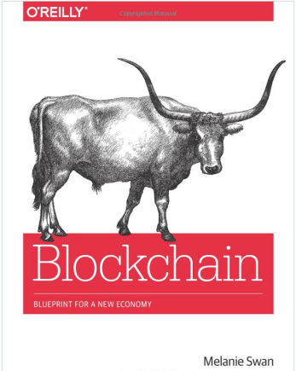
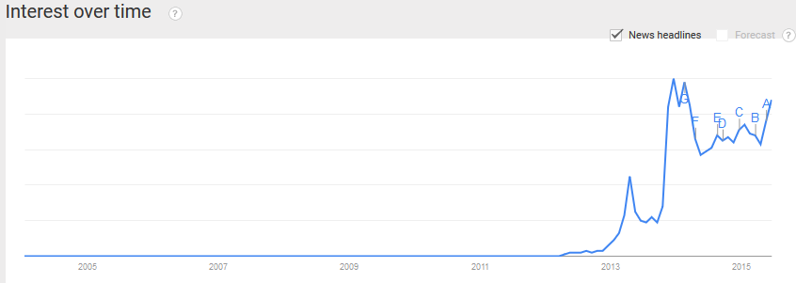
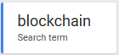
Blockchain

Slide 4
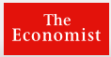
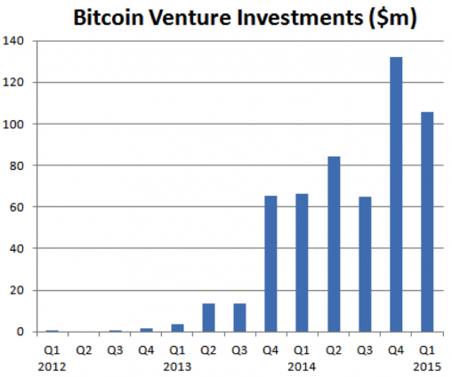
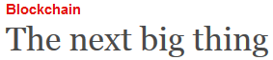

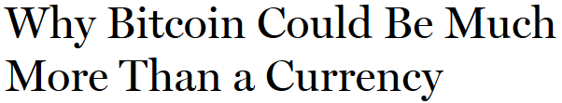
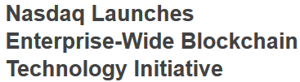

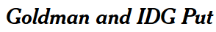
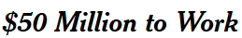
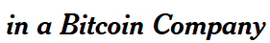

Bitcoin-FinTech-Blockchain Growth
Silicon Valley Bank: Global investment in FinTech is set to double from $10 billion in 2014 to $19.7 billion in 2015, and reach $46.1 billion by 2020
https://angel.co/bitcoin, http://thefinanser.co.uk/fsclub/2015/02/the-fintech-scene-is-so-hot-its-boiling.html
http://thenextweb.com/insider/2015/04/16/bitcoin-is-the-worlds-most-dangerous-idea/

Slide 5
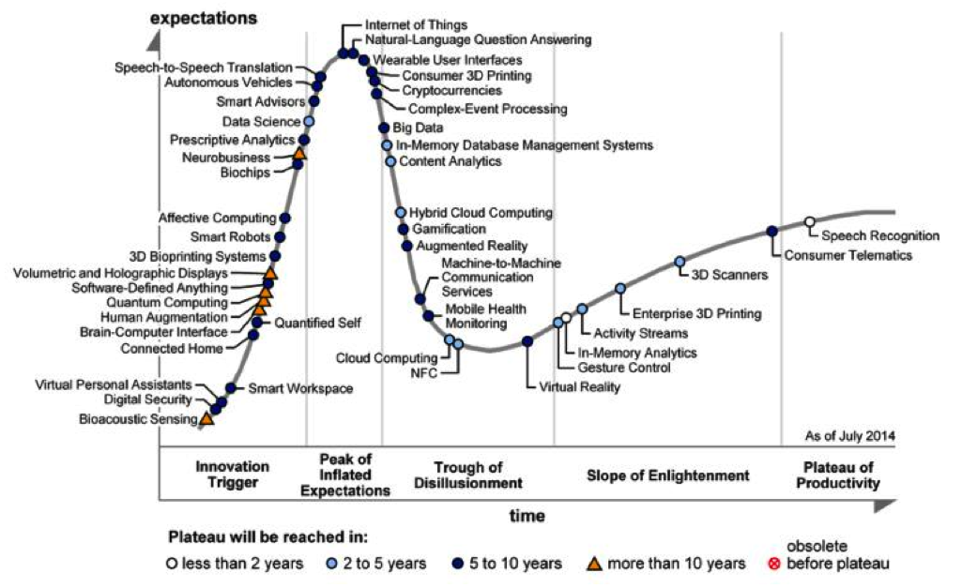
Gartner Emerging Technology Hype Cycle
Cryptocurrencies added July 2014
http://thenextweb.com/insider/2015/04/16/bitcoin-is-the-worlds-most-dangerous-idea/

Slide 6
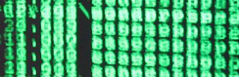
What is meant by Blockchain?
Context of Internet protocol stack, Bitcoin is just the first blockchain app
Application Layer
Gmail
Bitcoin (Btc) – $$, the digital currency
SMTP – simple mail transfer protocol
Bitcoin protocol – protocol for transferring the Bitcoin cryptocurrency
Application Protocol Layer
TCP/IP – transmission control protocol/Internet protocol
The Bitcoin Blockchain – the cryptographic ledger on which Bitcoin runs
General Protocol Layer

Slide 7
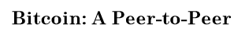
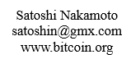
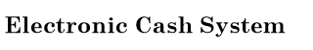
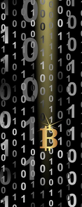
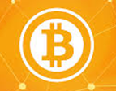
What is Bitcoin?
Finally – a digital currency that works!
Created by: Satoshi Nakamoto
Combination of BitTorrent technology (peer-to-peer file sharing) and public key cryptography
Solves double-spend problem
Copiability of digital assets; digital cash, like an image attached to an email, can be copied infinite times
Provides a secure network where any transaction can be independently confirmed unique and valid without a centralized intermediary like a bank or government
Satoshi Nakamoto’s original design for the blockchain (2008) https://bitcoin.org/bitcoin.pdf

Slide 8
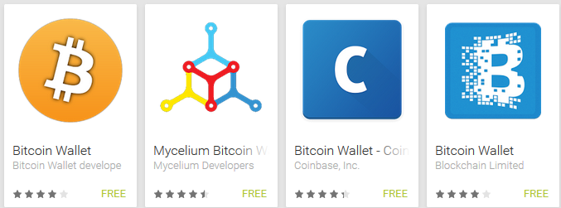
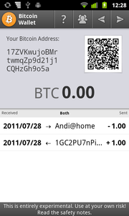
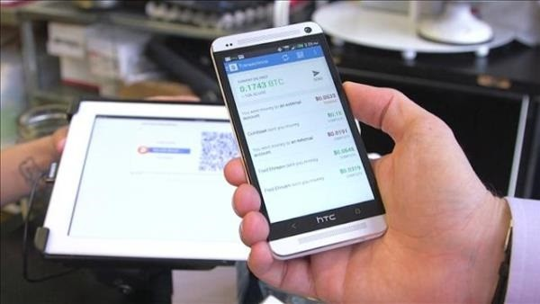
How does Bitcoin work?
Download software wallet app
Blockchain.info, Mycelium, etc.
Transfer Bitcoin via QR Code / public key address
See your transaction confirm, post to the blockchain

Slide 9
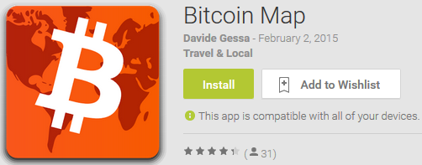
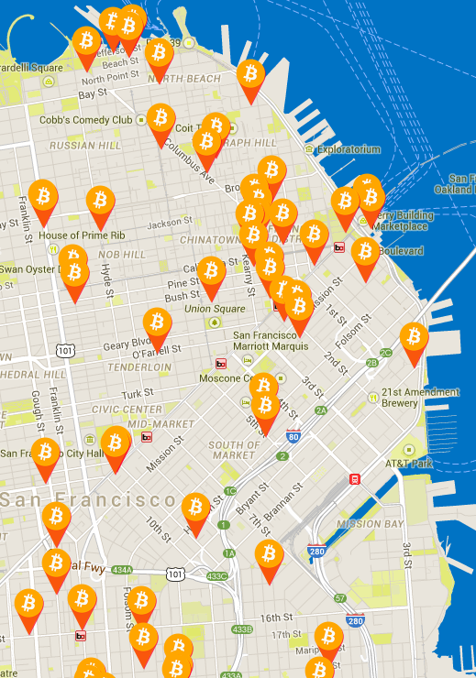
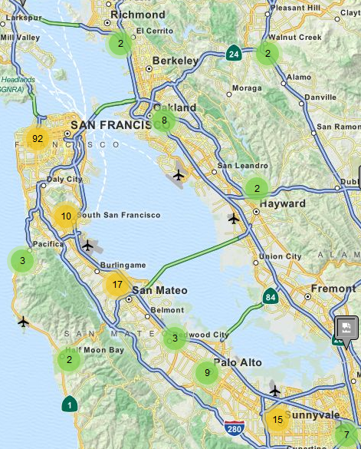
Where can I use Bitcoin?
http://bitcoinmaps.info/, http://coinmap.org/, https://airbitz.co/

Slide 10
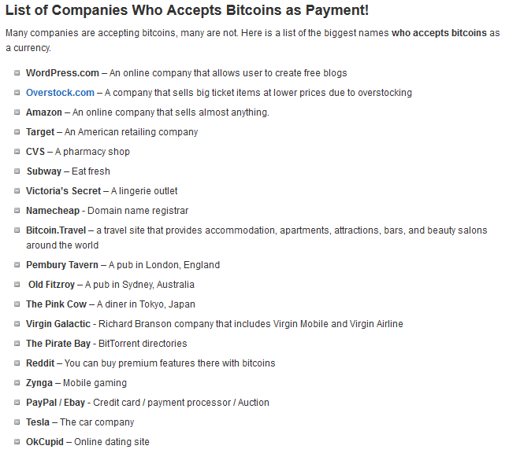
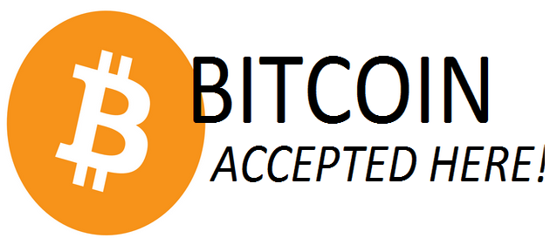
Use Bitcoin to avoid Digital Identity theft
Amazon, Overstock, Newegg, etc.
www.bitcoinvalues.net/who-accepts-bitcoins-payment-companies-stores-take-bitcoins.html

Slide 11


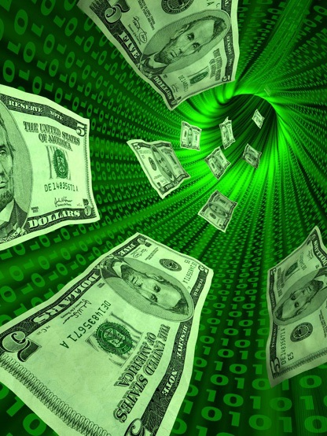
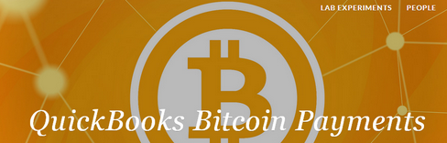
Economic and privacy arguments for Bitcoin
Vendor payments market
1-3% merchant transaction fee
Hack-able ‘honey pot’ identity databases
Banking services market
5 bn individuals worldwide without access to banking, financial, credit services
Remittances market
$4 tn global market, 5-30% transaction fee; immediate funds transfer solution
Successful examples suggest demand for digital payments
Starbucks mobile app, Apple Pay
http://www.bitcoinvalues.net/who-accepts-bitcoins-payment-companies-stores-take-bitcoins.html

Slide 12
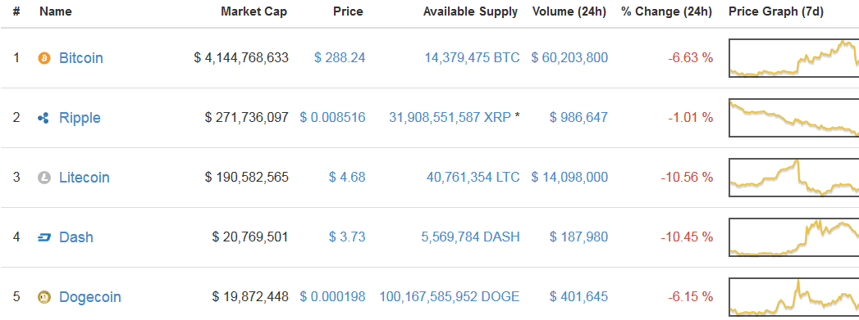
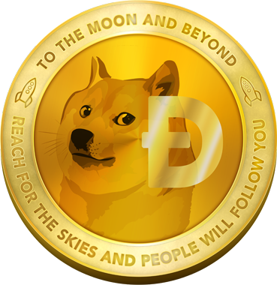
How big is the market and is it liquid? Which cryptocurrency should I use?
https://coinmarketcap.com/

Slide 13
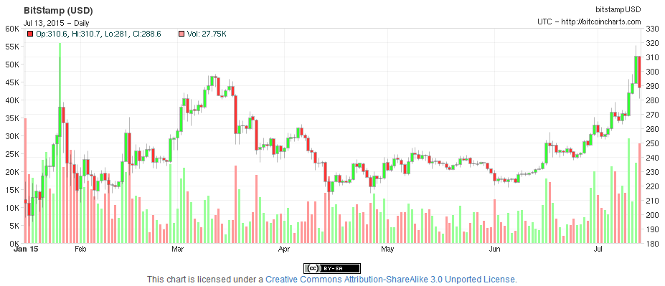
Bitcoin Price Volume Chart (1/1/15-7/13/15)
Price increase per events in Greece and China
http://bitcoincharts.com/

Slide 14
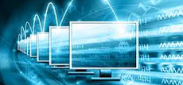
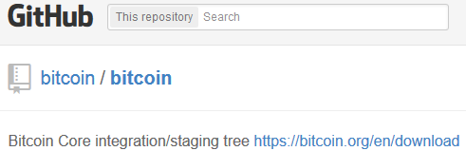

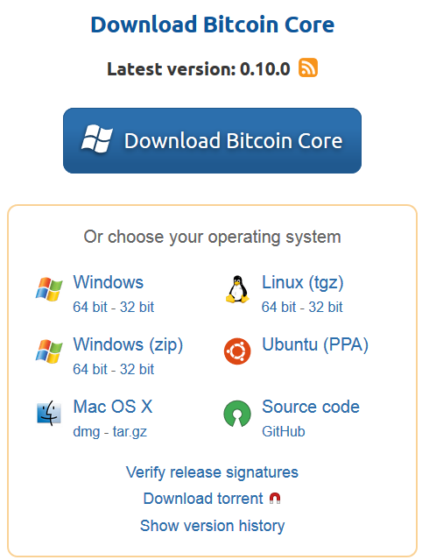
What is the blockchain?
The open-source software upon which Bitcoin runs
A technology protocol layer like TCP/IP
A transaction database, a decentralized public ledger of all transactions
Giant ‘interactive Google doc spreadsheet’ that anyone can view and administrators (miners) continually verify and update to confirm that each transaction is valid
Literally blocks (batches of transactions) in a chain, a sequential ledger of transactions
https://github.com/bitcoin/bitcoin, https://bitcoin.org/en/download, https://getaddr.bitnodes.io/

Slide 15
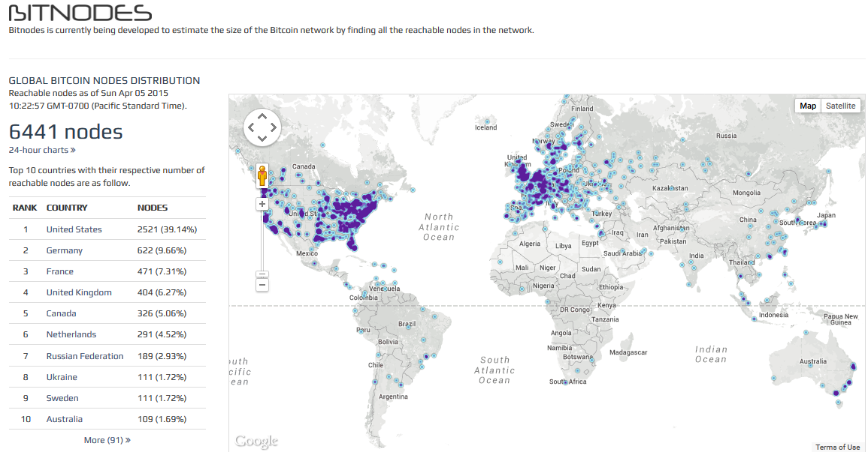
How robust is the network?
6441 Global Nodes running full Bitcoind (July 2015)
https://getaddr.bitnodes.io/

Slide 16

Financial and Public Records Applications
Financial instruments
Currency
Private equities
Public equities
Bonds
Derivatives Commodities
Spending records
Trading records
Mortgage/loan records
Servicing records
Crowdfunding
Microfinance
Public Records
Land titles
Vehicle registries
Business incorporations
Criminal records
Passports
Birth certificates
Death certificates
Voter Registration
Voting Records
Health/safety inspections
Building permits
Court records
http://forum.ethereum.org/discussion/1402/how-to-get-started-your-first-dapp-under-one-hour

Slide 17


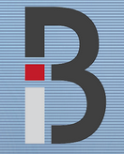
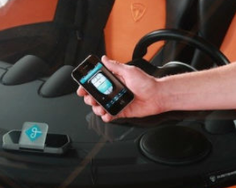
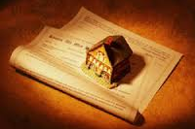
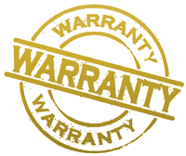
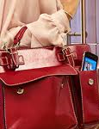
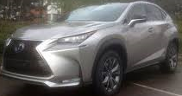

What is Smart Property?
Register assets to blockchain via unique key
Blocktrace ledger tracks diamonds
Real-time GPS LoJack tracking for any asset
Blockchain becomes an inventory, tracking, and buy-sell mechanism for all hard assets
Decentralized asset exchange
Digital authentication access system
Blockchain-based keyless entry
https://openbazaar.org/, http://www.edgelogic.net/blocktrace

Slide 18
Decentralized Application (Dapp) Ecosystem
Project Name and URL | Activity | Centralized Equivalent
OpenBazaar, BitMarkets, BitPremier https://openbazaar.org | Buy/sell items locally | Craigslist
LaZooz http://lazooz.org | On-demand ride service | Uber, Lyft
Twister http://twister.net.co | Social networking, peer-to-peer microblogging | Twitter, Facebook
Gems http://getgems.org | Social networking, private token-based social messaging | Twitter, SMS apps
Bitmessage https://bitmessage.org | Secure messaging (individual or broadcast) | SMS services
Storj http://storj.io/ | File storage | Dropbox, Google Drive
Onename https://onename.com/ BitID https://github.com/bitid/bitid Bithandle http://www.hackathon.io/bithandle | Digital identity verification | VeriFone, Verisign, Facebook
http://www.amazon.com/Bitcoin-Blueprint-New-World-Currency/dp/1491920491

Slide 19
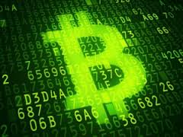
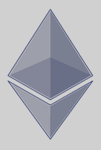

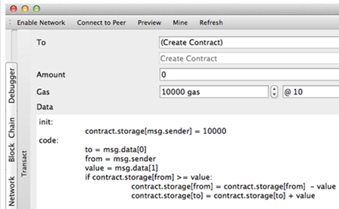

What are Smart Contracts?
Agreements between parties posted to the blockchain for automated execution
Cryptolaw: intersection of technological (inexorable, uninfringeable) and legal frameworks (flexible)
Smart Contract Examples:
Bet on high temperature tomorrow
Inheritance pay-out at age 21 or death of benefactor
Mortgage with automatic interest-rate resets
Code: Ethereum and Eris
https://github.com/ethereum/
https://erisindustries.com/
https://eng.erisindustries.com/smart%20contracts/2014/12/17/dennys-smart-contracting/ ,
http://forum.ethereum.org/discussion/1402/how-to-get-started-your-first-dapp-under-one-hour,
http://financialcryptography.com/mt/archives/001555.html

Slide 20
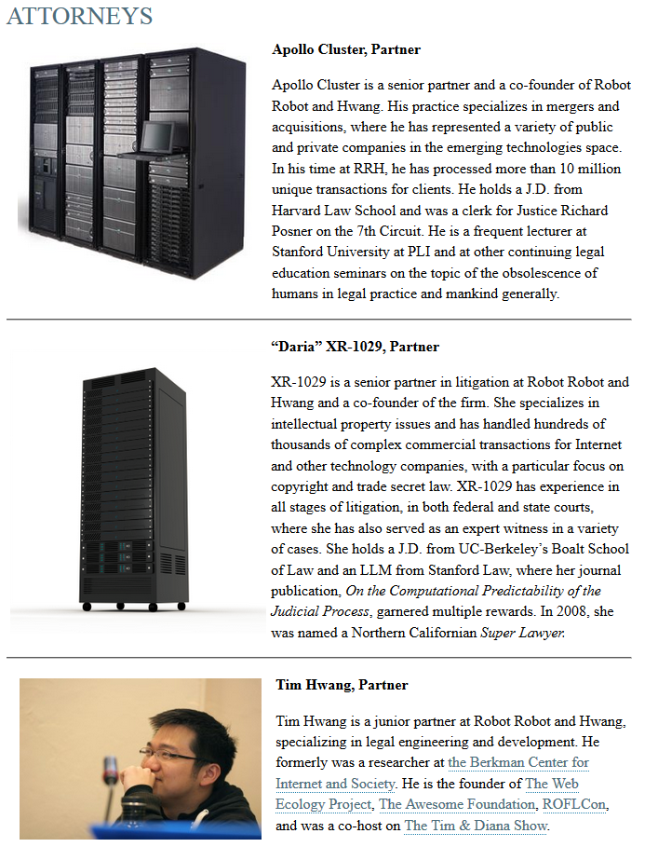

Smart Contract Law Firm?
Law is something to be radically reshaped by the emergence of technology, it is about the management and manipulation of data on an entirely new scale - Richard Susskind
http://www.robotandhwang.com/attorneys/

Slide 21
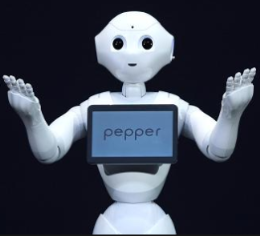
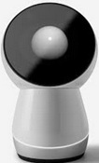

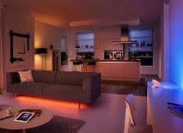
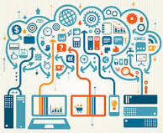

Blockchain IOT
M2M/IOT Bitcoin payment network to enable the machine economy
The economic layer the web never had
IOT 2020: 26 bn devices in a $7 tn market
Smarthome IOT networks (dist. privacy)
Self-mining ecologies
Privacy orchestration: devices, personal robotics, digital health assistants
IBM Adept
Blockchain + Messaging + BitTorrent
Blockchains as scalable communication and coordination mechanism
Smarthome IOT and Personal Robotics Coordination
Smartcity Connected Car Orchestration
http://www.zdnet.com/article/internet-of-things-market-to-hit-7-1-trillion-by-2020-idc/,
http://www.amazon.com/Bitcoin-Blueprint-New-World-Currency/dp/1491920491
https://gigaom.com/2014/09/09/check-out-ibms-proposal-for-an-internet-of-things-architecture-using-bitcoins-block-chain-tech/

Slide 22


Blockchain Health
Blockchain technology in health-related applications
EMRs: Personal Health Record Storage and Access
Personal health records stored and administered via blockchain
Users key-permission doctors and other parties into records
Health Research Commons (info processing)
Aggregated personal medical records, quantified self data commons (DNA.bits), genome and connectome files
Health Document Notary Services
Proof-of-insurance, test results, prescriptions, status, condition, treatment, physician referrals
Doctor Vendor RFP Services
(Like Uber drivers) doctors and health practices bid to supply medical services; automated bidding via tradenets
http://futurememes.blogspot.fr/2014/09/blockchain-health-remunerative-health.html

Slide 23







Blockchain Genomics
Jurisdictional regulation prevents individuals from having access to their own genetic data
http://genomesunzipped.org/2011/03/people-have-a-right-to-access-their-own-genetic-information.php

Slide 24




Blockchains: Global and Liberty-enhancing
Global governance for transnational organizations
WikiLeaks, ICANN, Wikipedia
Benefits of blockchain administration
Uplift to cloud from local jurisdictional regulations
Universal administration mechanism for global organizations
Structure promotes transparency, accountability, freedom
Namecoin: decentralized DNS
Snowden Affair
http://www.forbes.com/sites/andygreenberg/2010/12/07/visa-mastercard-move-to-choke-wikileaks/

Slide 25





Blockchain Government
Opt-in Personalized Government
Composting vs education
Reputation-based ID system, voting, dispute resolution, national income distribution, public documents registration and repository
Neighbor.ly
Self-directed community bonds
Precedentcoin
Crowdsourced legal services, justice entrepreneurs, blockchain arbitration
Sidekik
On-demand tele-attorney, private police
World’s First Blockchain Marriage:
David Mondrus and Joyce Bayo, October 5, 2014, Disney World FL, Coins in the Kingdom Bitcoin Conference, Jeffrey Tucker (Liberty.me) presiding
http://www.bitnation.co/, https://bitcoinmagazine.com/17066/first-blockchain-wedding-2/,
https://bitcoinmagazine.com/19813/sidekik-decentralized-video-streaming-storage/

Slide 26


Blockchain Representation and Voting
Delegative democracy (Liquid Democracy)
Voting power temporarily vested in delegates not long-term representatives
Group proposition development
Futarchy, two-step program
Traditional vote on outcomes (ex: GDP)
Prediction markets to determine specific proposals for achieving the outcome
Random Sample Elections
Randomly selected individuals vote on a single issue, blockchain orchestration
Convergent Facilitation
Register group needs as smart assets
https://bitcoinmagazine.com/17066/first-blockchain-wedding-2/,
http://www.bitnation-blog.com/latest-update-dec-22nd-2014/

Slide 27



Blockchain Legal
Notary Service, Attestation
Register contracts, agreements, wills (Proof of Existence, Factom)
Register, protect, and transact IP (Monegraph, Ascribe)
How it works
Hash + timestamp + blockchain record
http://www.proofofexistence.com/

Slide 28






Blockchain Science and What is Mining? Bitcoin: world’s largest supercomputer @ 42 petahashes/second
Mining is the process of adding transaction records to the public ledger by performing a computing task that is costly to execute but easy to verify
Issue: mining is purposefully wasteful to deter malicious players
‘Green’ mining projects
Primecoin
Foldingcoin
Gridcoin
Zennet
http://www.righto.com/2014/02/bitcoin-mining-hard-way-algorithms.html,
http://codinginmysleep.com/bitcoin-mining-in-plain-english/

Slide 29

Smartnetwork Application: Friendly AI
Argument…
Digital intelligences will be running on consensus-managed smartnetworks
Good reputational standing is required to conduct operations
Resource access, fund-raising, services-providing, contracts
Consensus only validates and records bonafide transactions from ‘good’ agents
Therefore all agents ‘good’
Swan, M. Cognitive Applications of Blockchain Technology. Cognitive Science 2015: The Annual Meeting of the Cognitive Science Society: Mind, Technology, and Society, Pasadena CA, July 2015. submitted. Swan, M. Blockchain Thinking: The Brain as a DAC (Decentralized Autonomous Organization). Texas Bitcoin Conference, Austin TX, March 27-29, 2015. accepted.

Slide 30


Derrida: Ontology of Joycean Consensus
Affirmation is not solo, “saying yes” is dependent upon another to hear it and acknowledge receipt
The affirmation relation is liberty-enhancing and totalization-resisting, the affirming and acknowledging parties, and the yes itself, remain distinct
“The two responses refer to each other without having any relationship between them. The two sign yet prevent the signature from gathering itself together [totalizing].”
The yes “addresses itself to some other which it does not constitute”
The yes avoids its own totalization, “The yes, by responding and countersigning, does not let itself be counted or discounted [totalized].”
Well-formed consensus: preserve the integrity of entities in a network of ad-hoc relations
Derrida. Ulysses Gramophone: Hear Say Yes In Joyce. Pp. 267, 296.
http://www.amazon.com/Bitcoin-Blueprint-New-World-Currency/dp/1491920491

Slide 31




Cryptocitizen Sensibility
A new relationship with authority and responsibility-taking
Digital safety: Backing up our money
Governance services vs. being governed
Trend: happened with news media, entertainment, stock-trading, health services; now happening with economics and politics
Freedom of choice, autonomy, and self-determination of economic and political systems as basic human rights
Responsibility for trust-generating behavior per reduced government involvement in decentralization

Slide 32

Blockchain Philosophy Smartnetwork Trust & Consensus Realities
Trust is manufactured on smartnetworks though consensus protocols and independent confirmations of truth states
Smartnetworks are a way of making new and pluralistic reality
Different network consensus protocols come to different truth states about the world, thus…
…creating mulitple realities, and
…the notion that realitiy is maleable and can be created; gives portability with reality

Slide 33





Blockchain Art
Rio, Tel Aviv, Hamburg, Barcelona, Seoul, Tokyo, New York
http://bitfilm.com/festival.html

Slide 34




Blockchain Art
Fine art paper wallets
http://cryptoart.com/

Slide 35


Blockchain Art
Someone used Bitcoin's ability to embed arbitrary text inside a transaction to put an ASCII Art Ben Bernanke into the Bitcoin blockchain
Cryptographic art
https://bitcointalk.org/index.php?topic=98392.0

Slide 36

Blockchain Art
Data visualization as art
http://fiatleak.com/

Slide 37




Blockchain Art
Data visualization as art
http://www.quora.com/What-are-some-of-the-best-Bitcoin-visualizations

Slide 38


Satoshi Dice betting game

Slide 39




Blockchain Literacy
‘Bitcoin MOOCs,’ ‘Kiva for literacy’
Peer-to-peer learning contracts
Literacy beyond reading
Technical, Agricultural, Vocational Literacy
Blockchain-based personal development contracts
QS-biometric utility function imputation and tracking
Maslow chains, subjectivation and actualization chains
Development Economics 2.0
Decentralized credit bureaus, literacy contracts, remittances, blockchain-tracked aid, microcredit,
Open-source FICO scores
Peer-vouched reputation

Slide 40

Blockchain Applications by Sector (selected)
Economics and Markets
Government & Legal
Science, Art, AI
IOT
Health
Currency
Payments & Remittance
Banking & Finance
Clearing & Settlement
Insurance
FinTech
Trading & Derivatives
QA & Internal Audit
Crowdfunding
Transnational orgs
Personalized governance services
Voting, propositions
P2P bonds
Tele-attorney services
IP registration and exchange
Tax receipts
Notary service and document registry
Agricultural & drone sensor networks
Smarthome networks
Integrated smartcity, connected car, smarthome sensors
Self-driving car
Personalized robots, robotic companions
Personalized drones
Digital assistants
Universal EMR
Health databanks
QS Data Commons
Big health data stream analytics
Digital health wallet
Smart property
HealthToken
Personal development contracts
Community supercomputing
Crowd analysis
P2P resourcenets
Film, dataviz
AI: blockchain advocates, friendly AI, blockchain learners, digital mindfile services
Crucial Blockchain Properties
Cryptoledger
Decentralized network
Trustless counterparties
Independent consensus-confirmed transactions
Permanent record
Public records repository
Notarization time-stamping hashes
Universal format
Accessibility
Communication (messaging)
Large-scale coordination
Entity ingress/egress
Transaction security
Universal format
Large-scale multi-data-stream integration
Privacy and security
Real-time accessibility
Large-scale infrastructural element for coordination
Checks-and-balances system for ‘good-player’ access
http://www.amazon.com/Bitcoin-Blueprint-New-World-Currency/dp/1491920491

Slide 41


Summary: The blockchain is…
A decentralized public transaction ledger
A markets and smart property management system for all of the world’s assets, smart property, and documents
An enabler of the M2M/IOT machine economy
A tool for science, health, literacy, and art applications
A new form of information technology, a decentralized system of checks and balances, an infrastructure, an organizing system that is universal and planetary-scale
Growing sensibility of the Cryptocitizen in self-authority responsibility-taking and smartnetworks as a means of conferring a reality truth state and societal shared trust
http://www.melanieswan.com/documents/BlockchainThinking_SWAN.pdf

Slide 42
Thesis
Philosophically, blockchain technology invites a new level of thinking about the possibilities for societal design and the sensibilities of the emerging Cryptocitizen
http://www.amazon.com/Bitcoin-Blueprint-New-World-Currency/dp/1491920491

Slide 43
2. Intro to Blockchain
Melanie Swan
Founder, Institute for Blockchain Studies
melanie@BlockchainStudies.org
www.BlockchainStudies.org
Slides: http://slideshare.net/LaBlogga

